Slide 1
Weather
Chapter 15
Clouds and Thunderstorms

Slide 2
Figure 15-1. The three states of water.

Slide 3
Figure 15-2. As air rises and expands, it cools adiabatically.

Slide 4
Figure 15-3. Cumuliform clouds form in unstable conditions; stratiform clouds form in stable conditions.

Slide 5
Figure 15-4. The temperature processes involved in the formation of a cumulus cloud.

Slide 6
Figure 15-5. Orographic uplift can lead to cloud formation.

Slide 7
Figure 15-6. Lenticular cloud cap (left), and mountain waves.

Slide 8
Figure 15-7. The Föhn wind effect.

Slide 9
Figure 15-8. Formation of turbulence clouds.

Slide 10
Figure 15-9. Cloud formation resulting from widespread ascent.

Slide 11
Figure 15-10. Nonshowery (steady) precipitation falls from stratiform clouds.

Slide 12
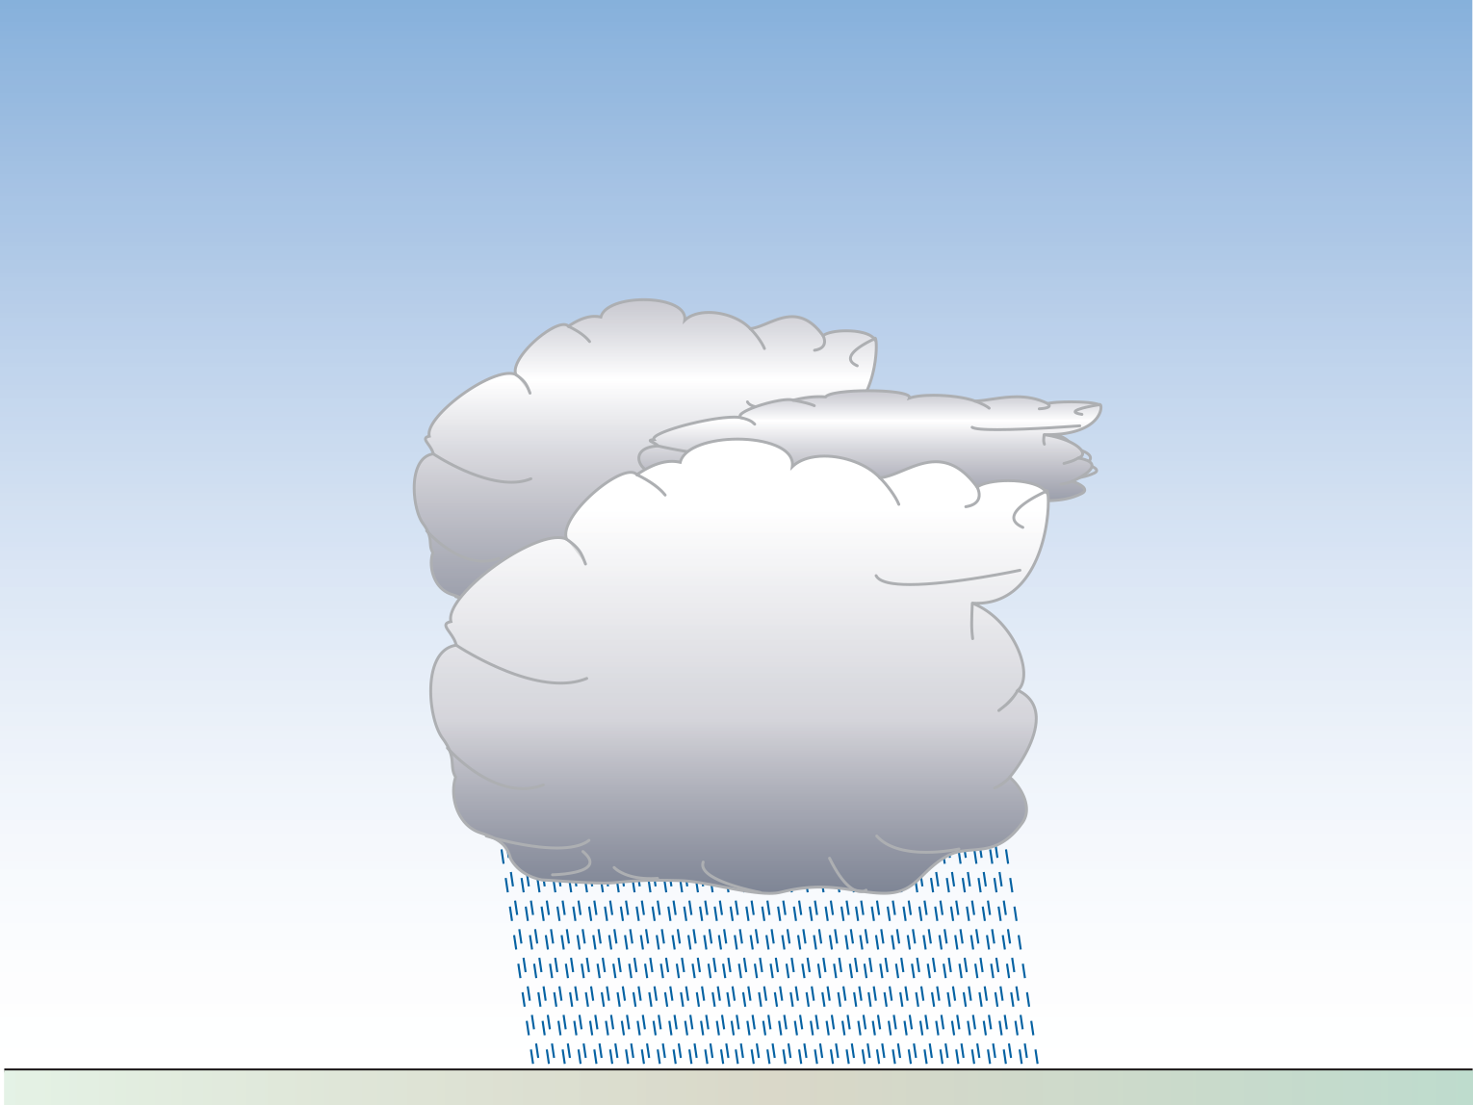
Figure 15-11. Rain showers fall from cumuliform clouds.

Slide 13
Figure 15-12. Virga.

Slide 14
Figure 15-13. The cumulus stage in the development of a thunderstorm.

Slide 15
Figure 15-14. The mature stage of a thunderstorm.

Slide 16
Figure 15-15. Thunderstorm dissipating.

Slide 17
Figure 15-16. Embedded thunderstorms can be a hazard to aviation.

Slide 18
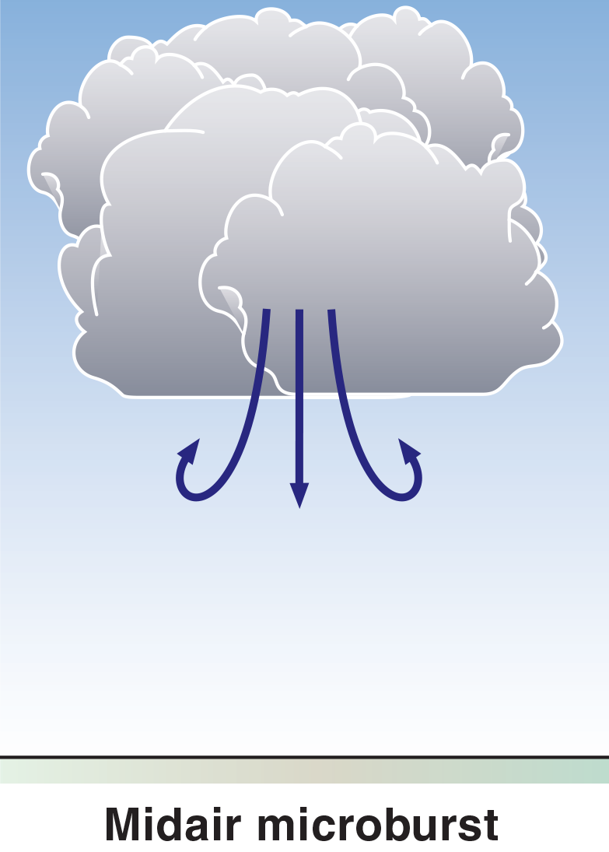
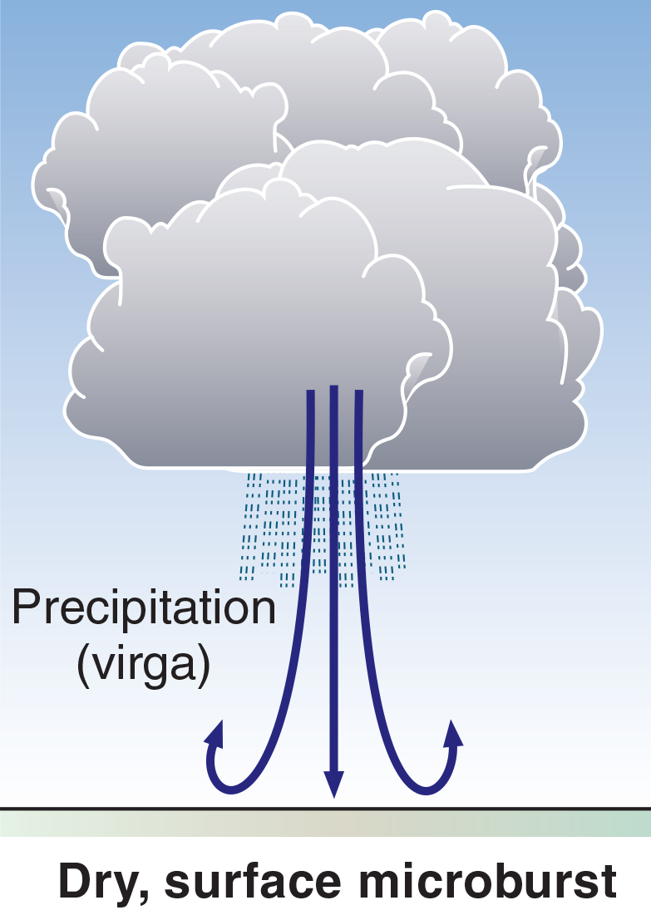
Figure 15-17. Some types of microbursts.

Slide 19
Figure 15-18. A tornado.

Slide 20
Figure 15-19. Positive lifted index.

Slide 21
Figure 15-20. Negative lifted index.

Slide 22
Figure 15-21. Fibrous cirrus.

Slide 23
Figure 15-22. Dense cirrus with a silky sheen.

Slide 24
Figure 15-23. Cirrus with hooks caused by jet stream wind.

Slide 25
Figure 15-24. Cirrostratus—halo is visible.

Slide 26
Figure 15-25. Cirrocumulus in grains—note halo to the left, indicating presence of ice crystals.

Slide 27
Figure 15-26. Cirrocumulus formed in ripples.

Slide 28
Figure 15-27. Thin altostratus—sun visible as through ground glass.

Slide 29
Figure 15-28. Thick, opaque altostratus—bluish grey, giving light rain.

Slide 30
Figure 15-29. Broken layer of altocumulus—in rounded elements, formed by turbulence.

Slide 31
Figure 15-30. Sheet of altocumulus in rolls—formed in the shear between wind layers.

Slide 32
Figure 15-31. Lenticular (lens-shaped) altocumulus—formed in the crest of mountain waves; expect strong turbulence.

Slide 33
Figure 15-32. Altocumulus resulting from the spreading out of cumulus tops under a stable layer.

Slide 34
Figure 15-33. Altocumulus floccus—Ac in the form of “wool tufts.” Both Ac castellanus and Ac floccus indicate instability and moisture in the middle troposphere, with the possibility of thunderstorms forming.

Slide 35
Figure 15-34. Altocumulus castellanus—“castles in the air.”

Slide 36
Figure 15-35. Stratocumulus in a continuous layer, base around 2,000 ft AGL.

Slide 37
Figure 15-36. Stratocumulus in a broken layer, base around 4,000 ft AGL.

Slide 38
Figure 15-37. Broken stratus (stratus fractus) formed by the breaking up of a stratus layer.

Slide 39
Figure 15-38. stratus with a low base.

Slide 40
Figure 15-39. Edge of stratus sheet, base around 300 ft AGL (altostratus above).

Slide 41
Figure 15-40. Nimbostratus.

Slide 42
Figure 15-41. Cumulus of medium development.

Slide 43
Figure 15-42. Congested towering cumulus.

Slide 44
Figure 15-43. Cumulonimbus cloud in the early mature stage, starting to flatten at the top.

Slide 45
Figure 15-44. Line of cold-stream thunderstorms.

Slide 46
Figure 15-45. Classic, fully developed thunderstorm.

Slide 47
Figure 15-46. Mature Cb cloud, entering dissipating stage.

Slide 48
Figure 15-47. A heavy rain shower from a storm cell within a cumulonimbus cloud accompanying a cold front.

Slide 49
Figure 15-48. Lightning from an evening thunderstorm.

Slide 50
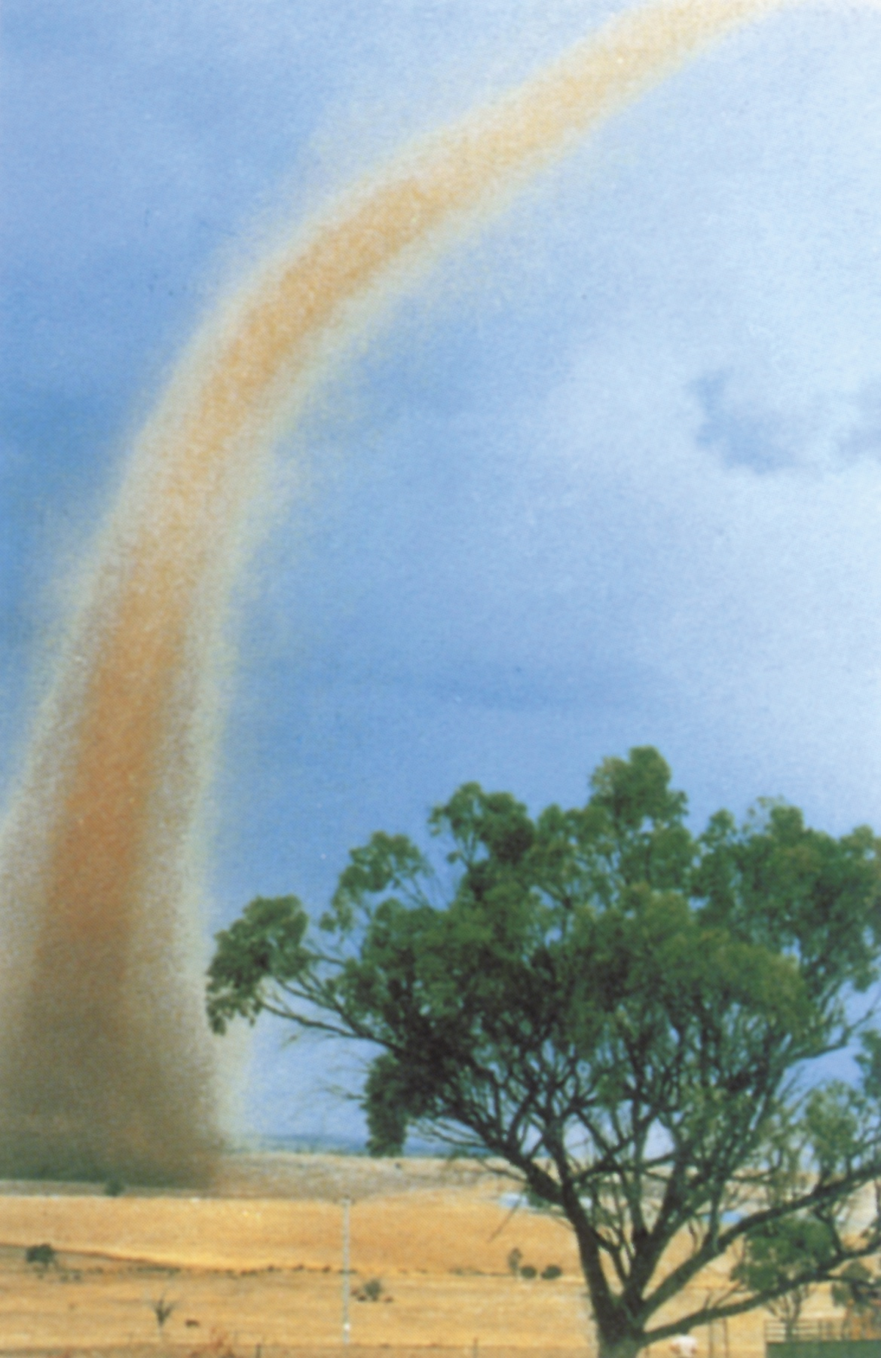
Figure 15-49. Tornadoes—to be avoided!

Slide 51
Figure 15-50. Weather associated with passage of a cold front.

Slide 52
Figure 15-51. Clouds formed by broad lifting of moist, stable air.

Slide 53
Figure 15-52. Stationary caps on the peaks.

Slide 54
Figure 15-53. Sign of an Inversion in the early morning.

Slide 55
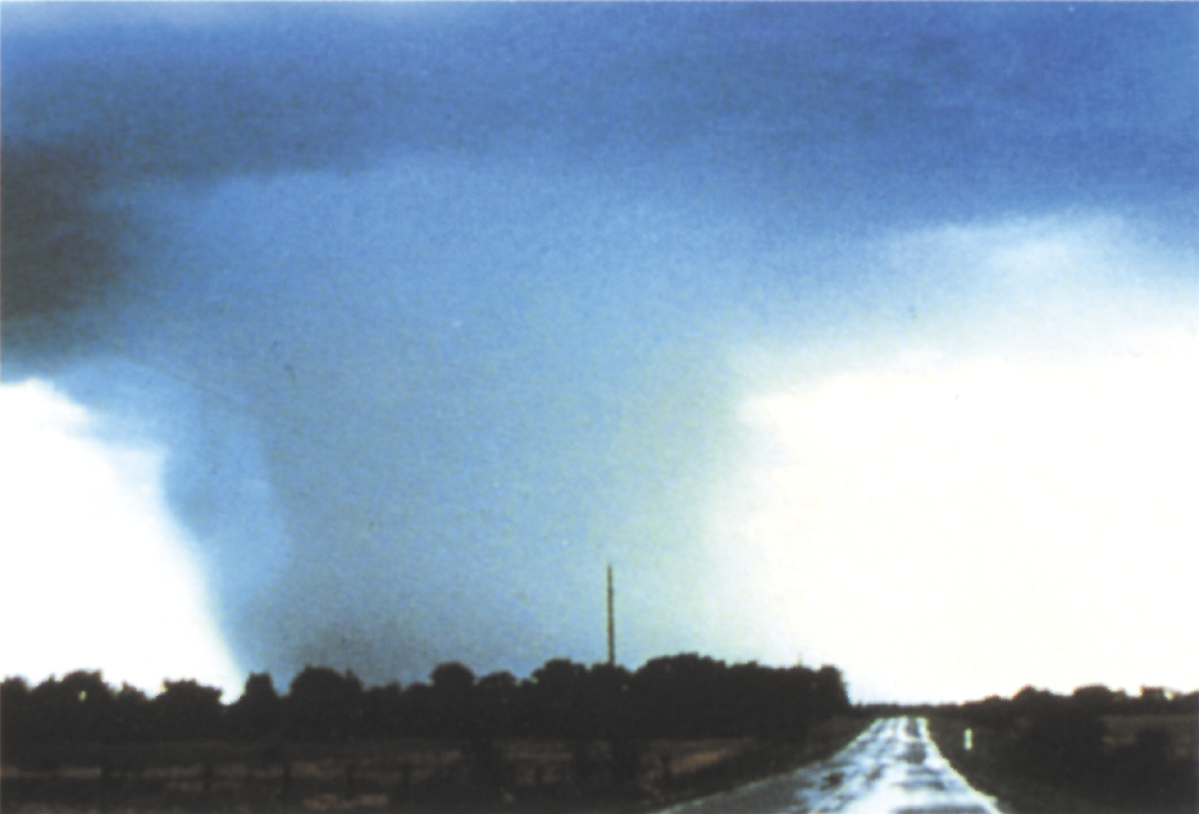
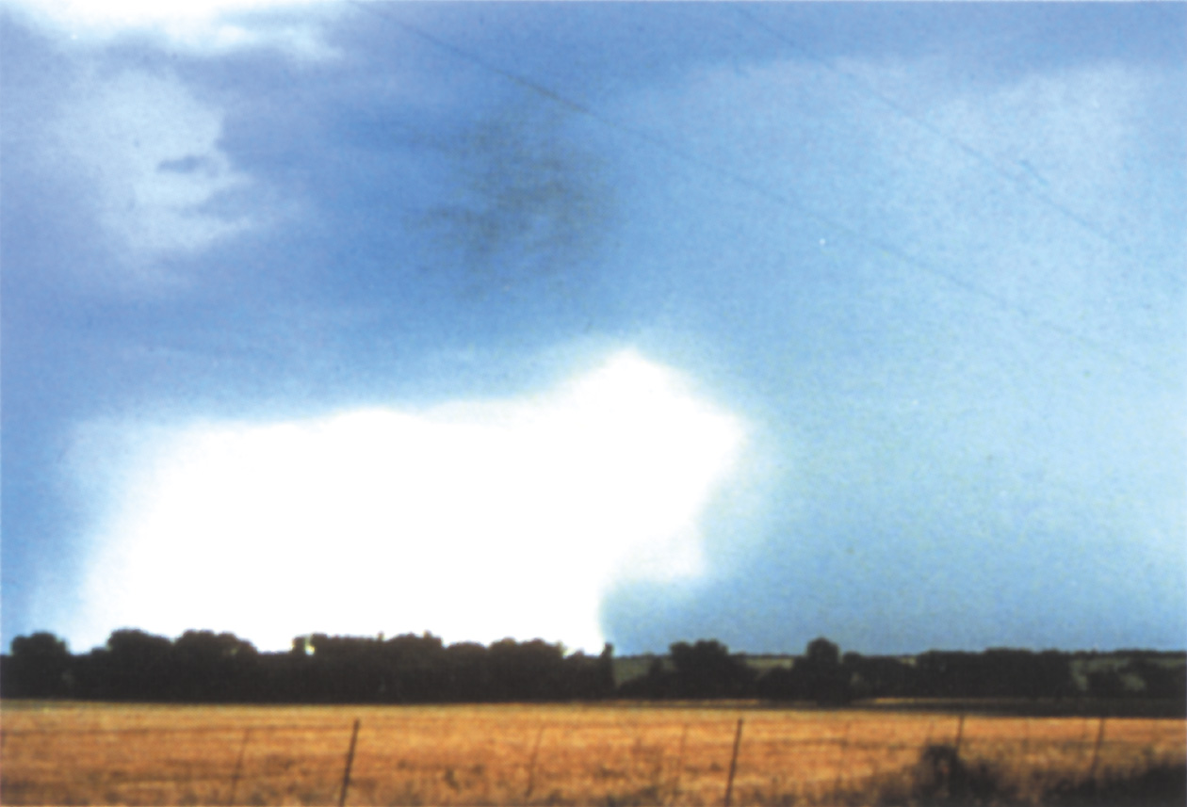
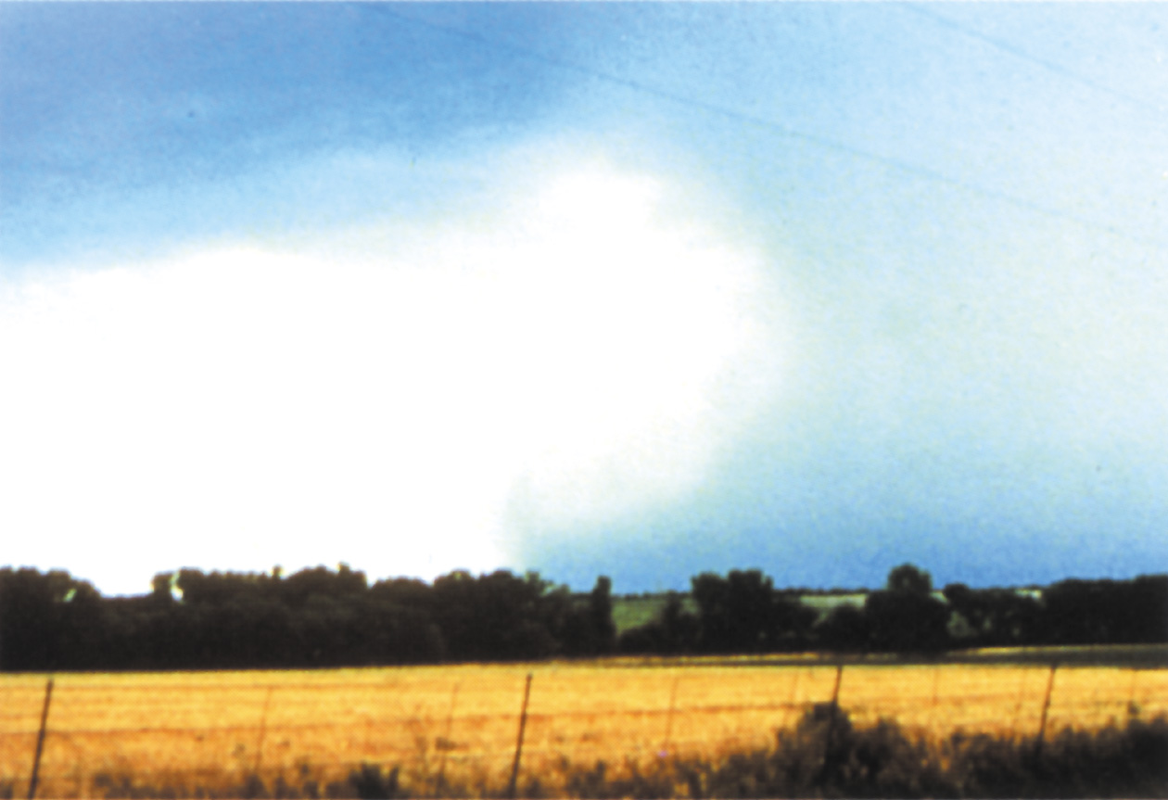
Figure 15-54. Photo sequence showing the development of a potentially destructive microburst.

Slide 56
Figure 15-55. A Wet microburst emanating from the base of a cumulonimbus cloud.

Slide 57
Figure 15-56. Example of NOAA Aviation Weather Overview with satellite, visible fog, and radar imagery overlay.

